Slide 1
Enhancing Input On and Above the Interactive Surface with Muscle Sensing
Hrvoje Benko, T. Scott Saponas, Dan Morris, and Desney Tan
Microsoft Research and University of Washington
ACM ITS 2009

Slide 2
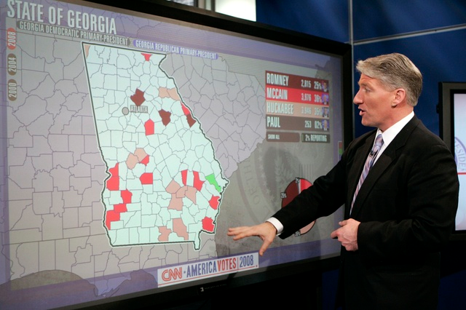
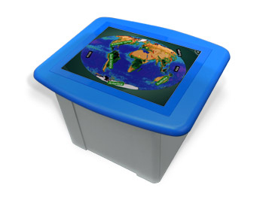
Touch Sensitive Interfaces
Problems:
Contact identification
Pressure sensing
Above the surface sensing
- gloves, Visual Touchpad
- FTIR, FSR
- SecondLight, DepthTouch
Notes:
TODO redo this slide a bit

Slide 3
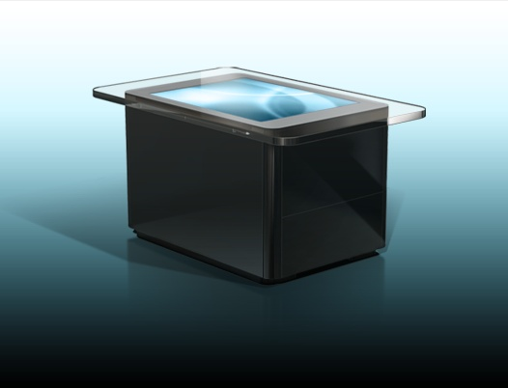
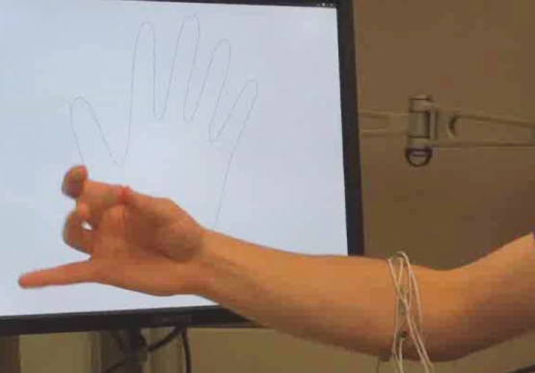
Our Approach

Slide 4
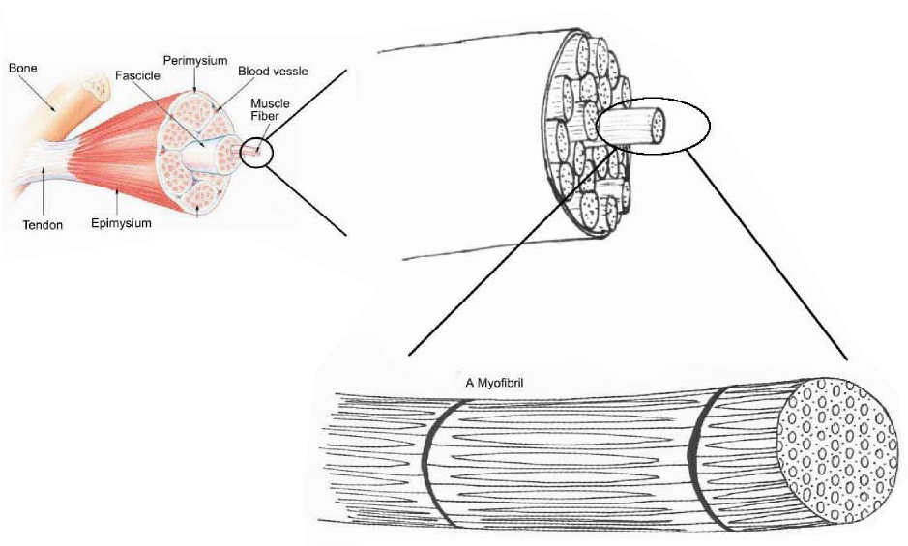
Sensing Muscle Activation
Electrical signal can be sensed by Electromyography (EMG)
Notes:
nervous system, motor neuron, action potential, muscle fiber
For those of us who are not biology or medical experts here is a quick primer on muscles and muscle sensing
There are muscles for breathing and heartbeat
And then there are muscles we use for locomotion, and those are what we are talking about using in muscle-computer interfaces
The neurological signal for muscle activation can be sensed at the surface of the skin, and we want to make use of this type of physiological sensing for computer input.

Slide 5
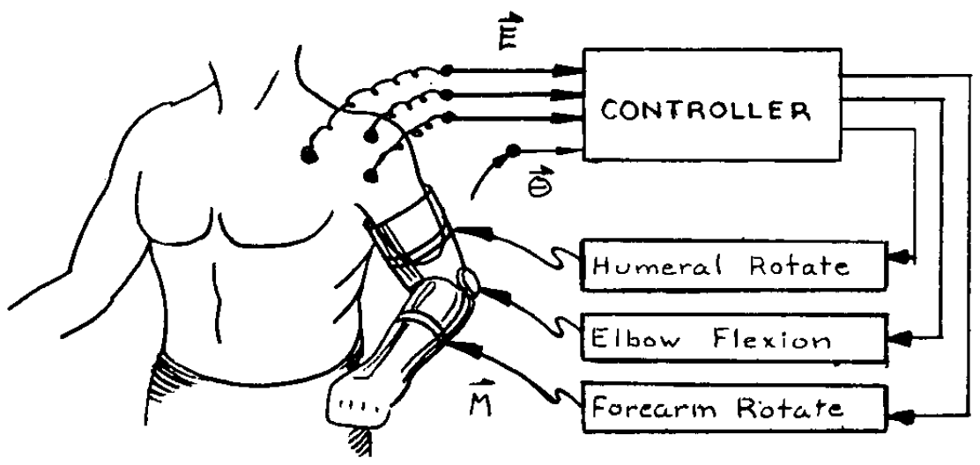
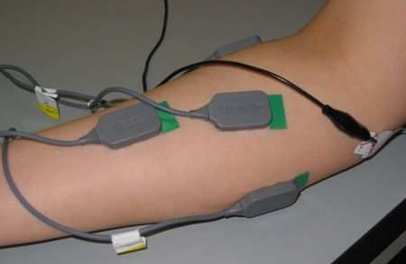
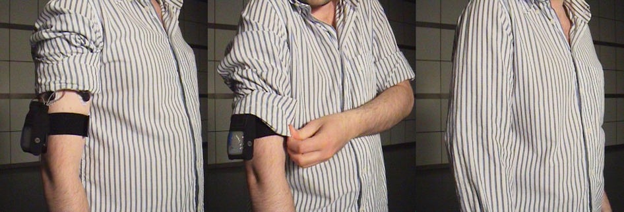
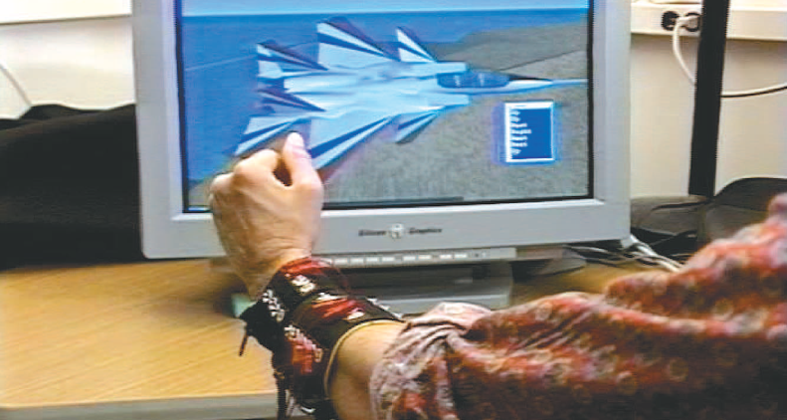
Related Work
Jacobsen, et al. “Utah Arm”, ‘74
Naik, et al. “Hand gestures”, ‘07
Costanza, et al. “Intimate interfaces in action”, CHI ‘05
Wheeler & Jorgensen “Neuroelectric joysticks”, ‘02
Notes:
1890 the term electromyography introduced
Closely related to EEG – electroencephalography

Slide 6
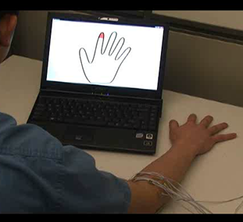
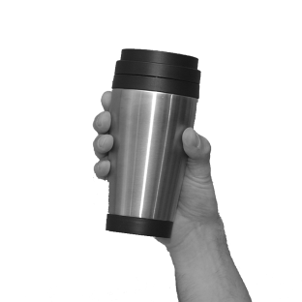
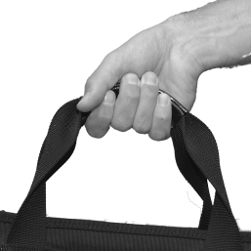
Related Work
Offline
Real-Time
Saponas et al., CHI ‘09
Saponas et al., UIST’09

Slide 7
Complimentary Modalities
Interactive Tabletops
Muscle Sensing
Easy
Location and footprint of multiple contacts
Difficult
Identification of contacts
Sensing of pressure
Sensing above the surface
Easy
Sensing muscle activation
Identifying muscles
Difficult
Spatial location of body parts

Slide 8
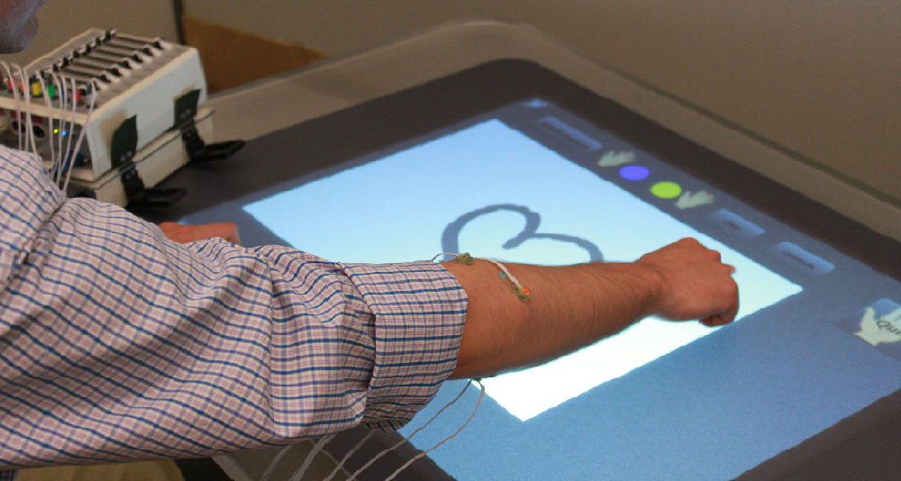
Our Equipment
BioSemi EMG
Monitor/Amplifier
Forearm sensors
Microsoft Surface

Slide 9
Challenges in Sensing Fingers

Slide 10
EMG Sensors & Data

Slide 11
Stimulus Response Training

Slide 12
Gesture Classification
X 8 Sensors
30 millisecond sample
labeled
training data
machine learning
Support Vector
Machine
user specific model
Notes:
Standard Machine Learning Setup
Based on related work in EMG sensing and our previous work with EEG sensing we…
PER USER MODELS
figures showing data->features->training->model-> classification
For our experiment, we used the Sequential Minimal Optimization (SMO) version of support vector machines as implemented in the Weka toolkit
I’ve told you now that we put 8 sensors on people had them perform 4 gesture sets of 4-5 gestures each at least 50 times.
So what did we do with all this data?
We conducted offline analysis using techniques we decided upon before running the experiment

Slide 13
Gesture Classification
X 8 Sensors
30 millisecond sample
labeled
training data
machine learning
Features
Support Vector
Machine
Root Mean Square (RMS)
ratios between channels
Frequency Energy
10 Hz bands
user specific model
Phase Coherence
ratios between channels
Notes:
Standard Machine Learning Setup
Based on related work in EMG sensing and our previous work with EEG sensing we…
PER USER MODELS
figures showing data->features->training->model-> classification
For our experiment, we used the Sequential Minimal Optimization (SMO) version of support vector machines as implemented in the Weka toolkit
I’ve told you now that we put 8 sensors on people had them perform 4 gesture sets of 4-5 gestures each at least 50 times.
So what did we do with all this data?
We conducted offline analysis using techniques we decided upon before running the experiment

Slide 14
Gesture Classification
X 8 Sensors
machine learning
30 millisecond sample
user specific model
Features
Root Mean Square (RMS)
ratios between channels
Support Vector
Machine
Frequency Energy
10 Hz bands
Phase Coherence
ratios between channels
gesture
classification
Notes:
Standard Machine Learning Setup
Based on related work in EMG sensing and our previous work with EEG sensing we…
PER USER MODELS
figures showing data->features->training->model-> classification
For our experiment, we used the Sequential Minimal Optimization (SMO) version of support vector machines as implemented in the Weka toolkit
I’ve told you now that we put 8 sensors on people had them perform 4 gesture sets of 4-5 gestures each at least 50 times.
So what did we do with all this data?
We conducted offline analysis using techniques we decided upon before running the experiment

Slide 15
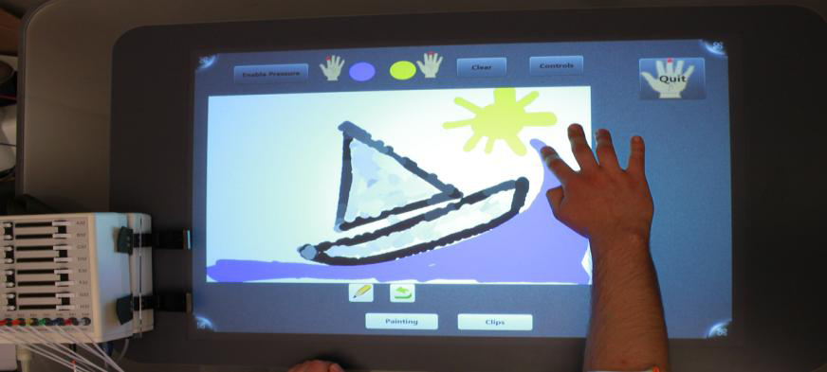
EMG + Surface Interactions

Slide 16
Pressure Sensing

Slide 17
Finger Identification

Slide 18
Off-Surface Interactions
Undo

Slide 19
Off-Surface Interactions
Pinch & Throw

Slide 20
UI Considerations
Dealing with lag
Classification lag:
Pressure (<150ms)
Finger ID (<300ms)
Hand flick (<50ms)
Our guideline:
Instantaneous response
Fill missing details ASAP

Slide 21
UI Considerations
Finger-dependent UI elements
Pre-sense visualizations

Slide 22
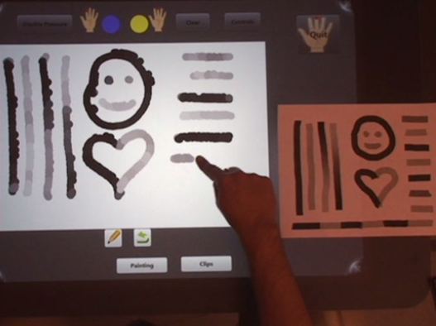
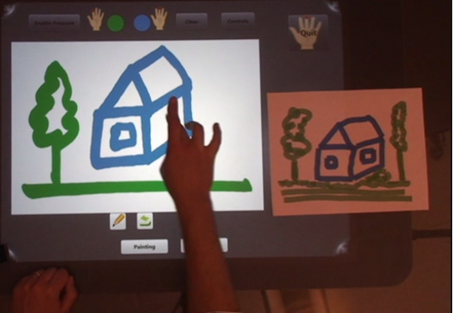
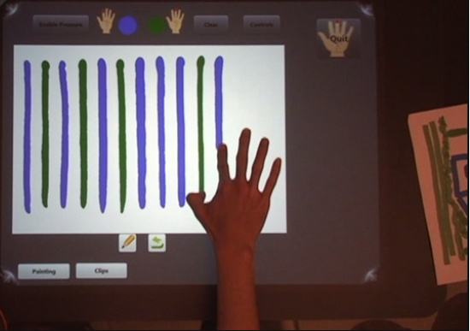
Pilot Experiment
6 participants (3F, 3M)
90 min sessions
Five tasks
Copy images with pressure-sensitive painting
Copy images with finger-dependent painting
Draw alternating vertical lines
Draw plus undo alternate numbers
Cut-copy-paste images between 2 canvases

Slide 23
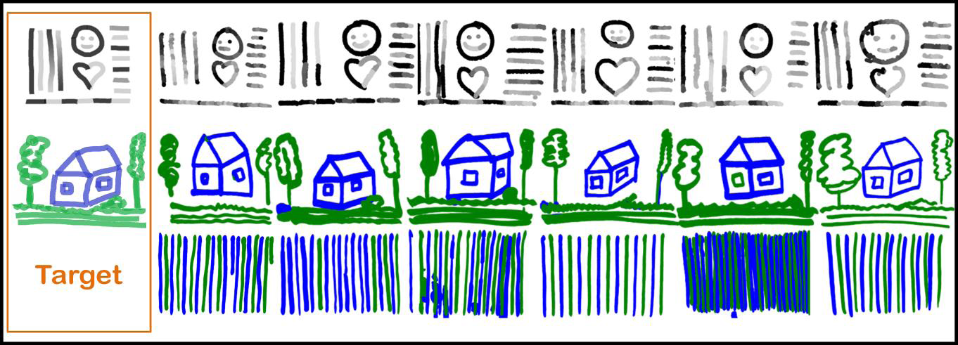
Experiment Results
Confirmed feasibility of our approach
Across tasks/participants accuracy >90%
1 participant ~ 75% accuracy for finger ID
Participants

Slide 24
Limitations
Per user/per session calibration
Training method is critical
90% might not be good enough
Single contact at the time
Not all fingers are created equal
Bulky, expensive equipment
Notes:
TODO

Slide 25
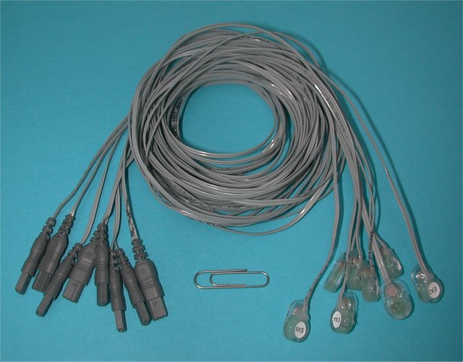
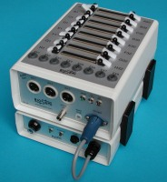
Big Challenges
Wires
Sensors & Equipment
Training
Reliability/Repeatability

Slide 26
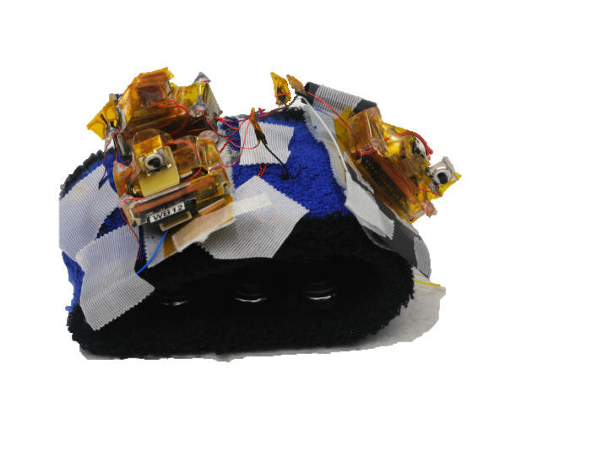
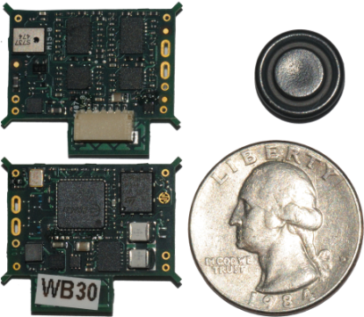
Addressing the Challenges
A wireless, dry-electrode armband
Cross-session training

Slide 27
Wireless EMG Armband

Slide 28
Thank You
Hrvoje Benko
benko@microsoft.com
Graduating!
T. Scott Saponas Dan Morris Desney Tan

Slide 29
Extras

Slide 30
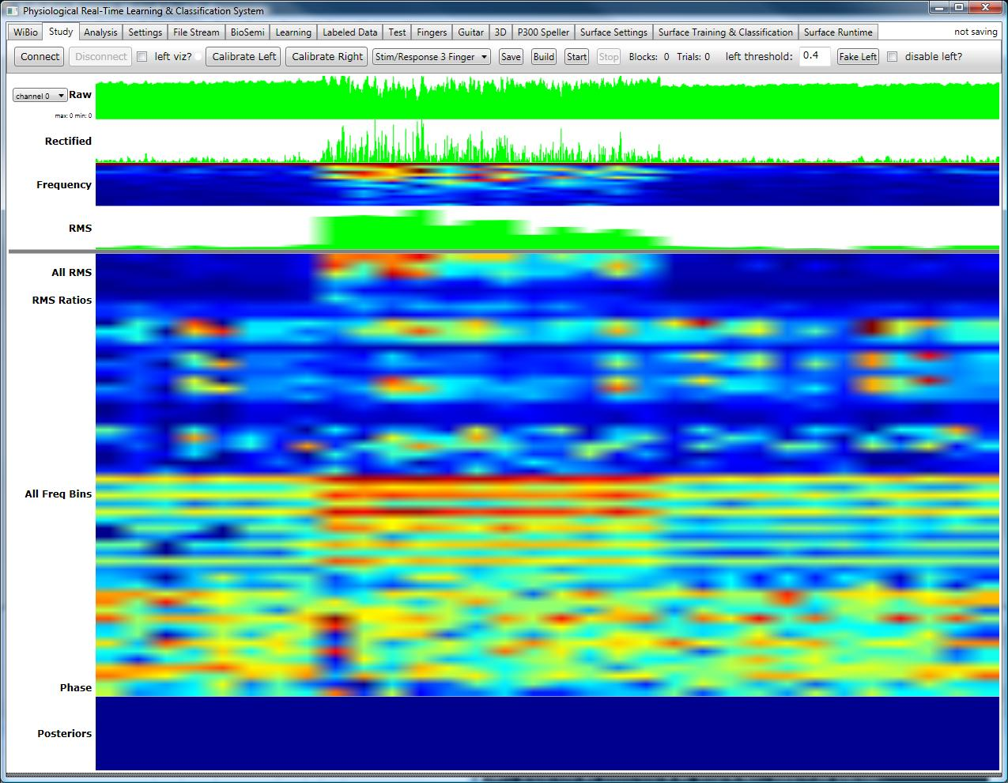
Sensor Stream

